Slide 1
DATA SCIENCE MINOR PROJECT

Slide 2
BOSTON HOUSE PRICE PREDICTION

Slide 3
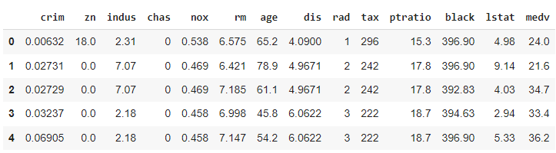
Data Description

Slide 4
DATA DESCRIPTION
The following features provided help us to predict housing prices in boston
CRIM : per capita crime rate by town
ZN: proportion of residential land zoned for lots over 25,000 sq. ft.
INDUS: proportion of non-retail business acres per town.
CHAS: Charles River dummy variable (1 if tract bounds river; 0 otherwise)
NOX: nitric oxides concentration (parts per 10 million)
RM: average number of rooms per dwelling
RAD: index of accessibility to radial highways

Slide 5
DATA DESCRIPTION
DIS - weighted distances to five Boston employment centers
RAD - index of accessibility to radial highways
TAX - full-value property-tax rate per $10,000
PTRATIO - pupil-teacher ratio by town
B - 1000(Bk - 0.63)^2 where Bk is the proportion of blacks by town
LSTAT - % lower status of the population
MEDV - Median value of owner-occupied homes in $1000’s

Slide 6
Approach
My Approach for prediction of housing prices in boston
Analysing the data given
Visualising the data by using matplotlib and seaborn python packages
Preprocessing the given data by using standard scaler from sklearn package
Prediction using Linear Regression

Slide 7
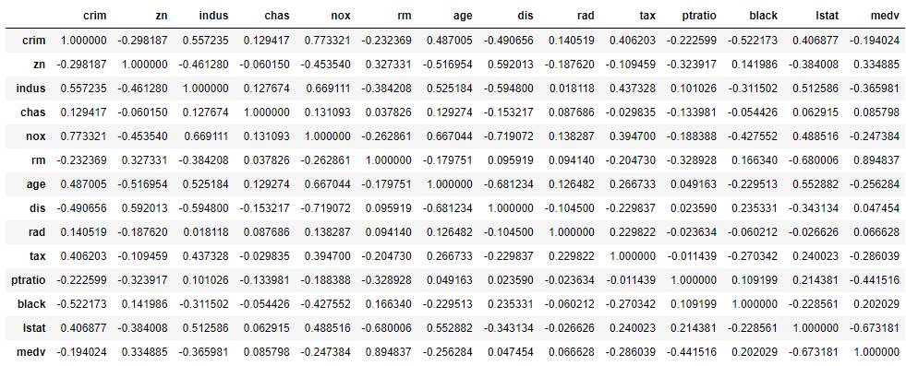
Data Visualization
Finding correlation of every pair of features and visualize the correlations using a heatmap.

Slide 8
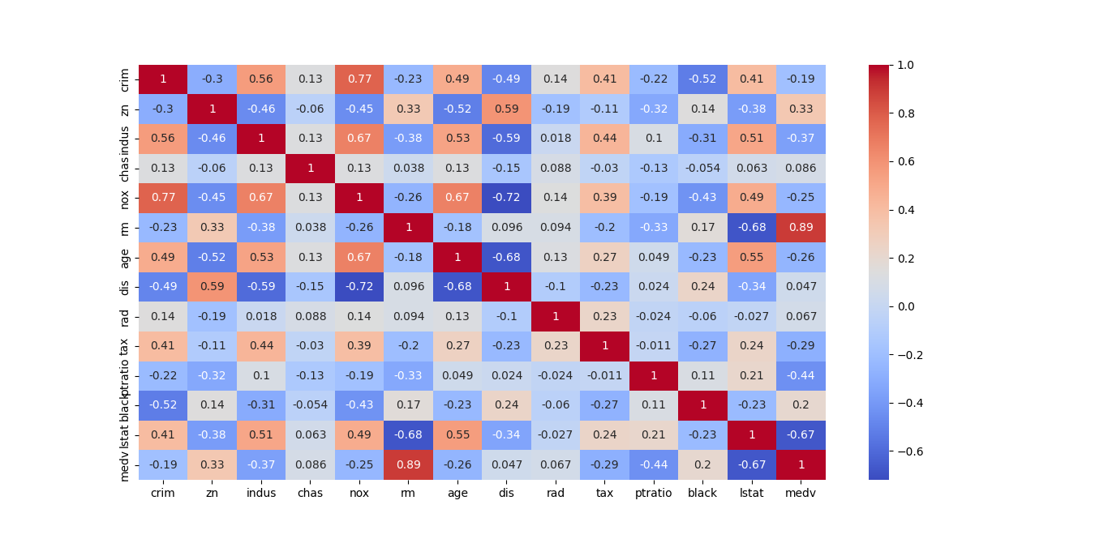
Data Visualization

Slide 9
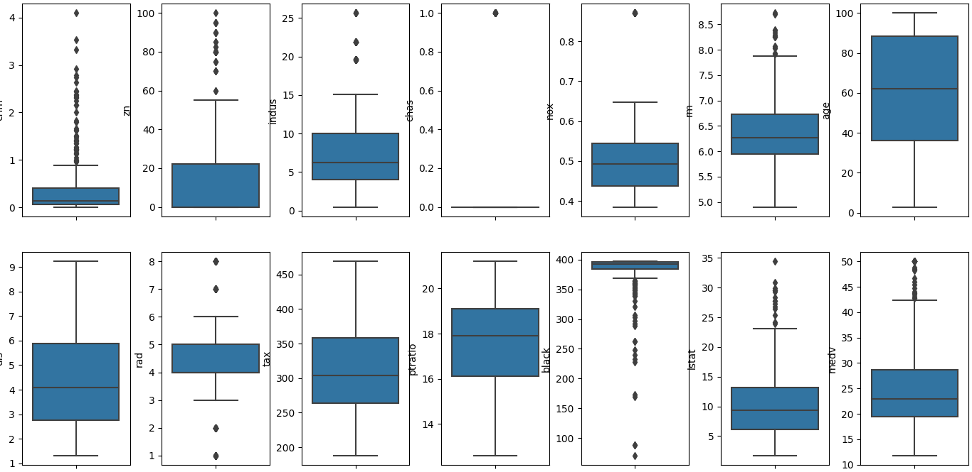
Data Visualization
Box plot representing variables in the dataset

Slide 10
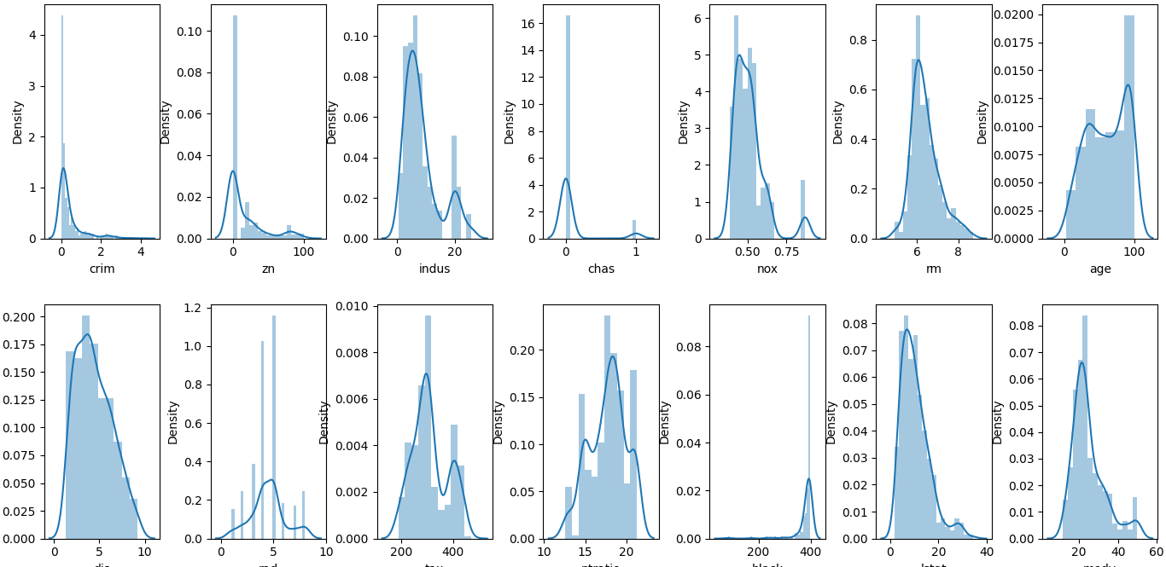
Data Visualization
Distribution plot representing variables in the dataset

Slide 11
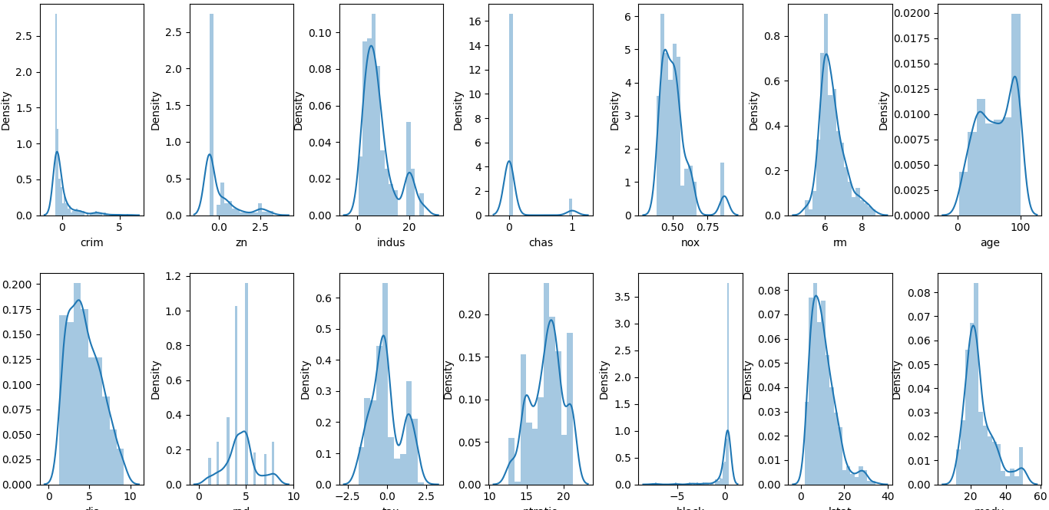
Data Visualization
Distribution plot representing variables in the dataset

Slide 12
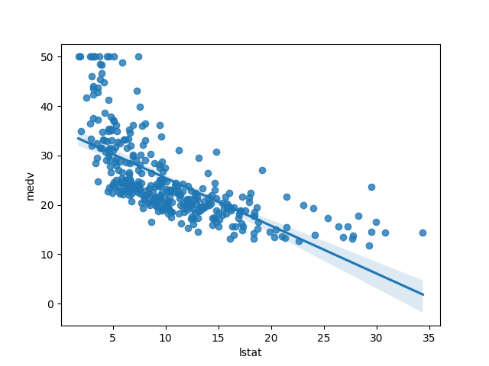
Data Visualization
Reg plot between medv and lstat

Slide 13
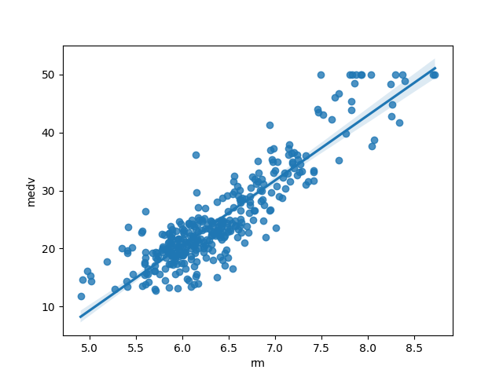
Data Visualization
Reg plot between medv and rm.

Slide 14
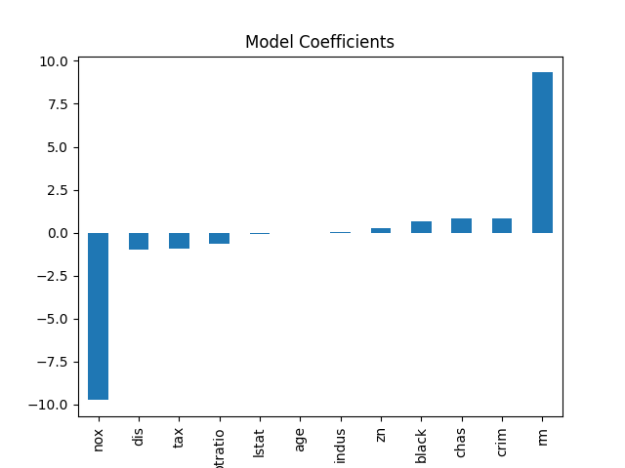
Data Visualization

Slide 15
Algorithms / Machine Learning Model
I Have used Linear Regression Model for prediction. Since prediction is a regression problem , Linear Regression s a machine learning algorithm based on supervised learning. It performs a regression task. Regression models a target prediction value based on independent variables. It is mostly used for finding out the relationship between variables and forecasting. Different regression models differ based on – the kind of relationship between dependent and independent variables, they are considering and the number of independent variables being used.

Slide 16
Thanks For Viewing
T. Sharon Vijay

